Slide 1
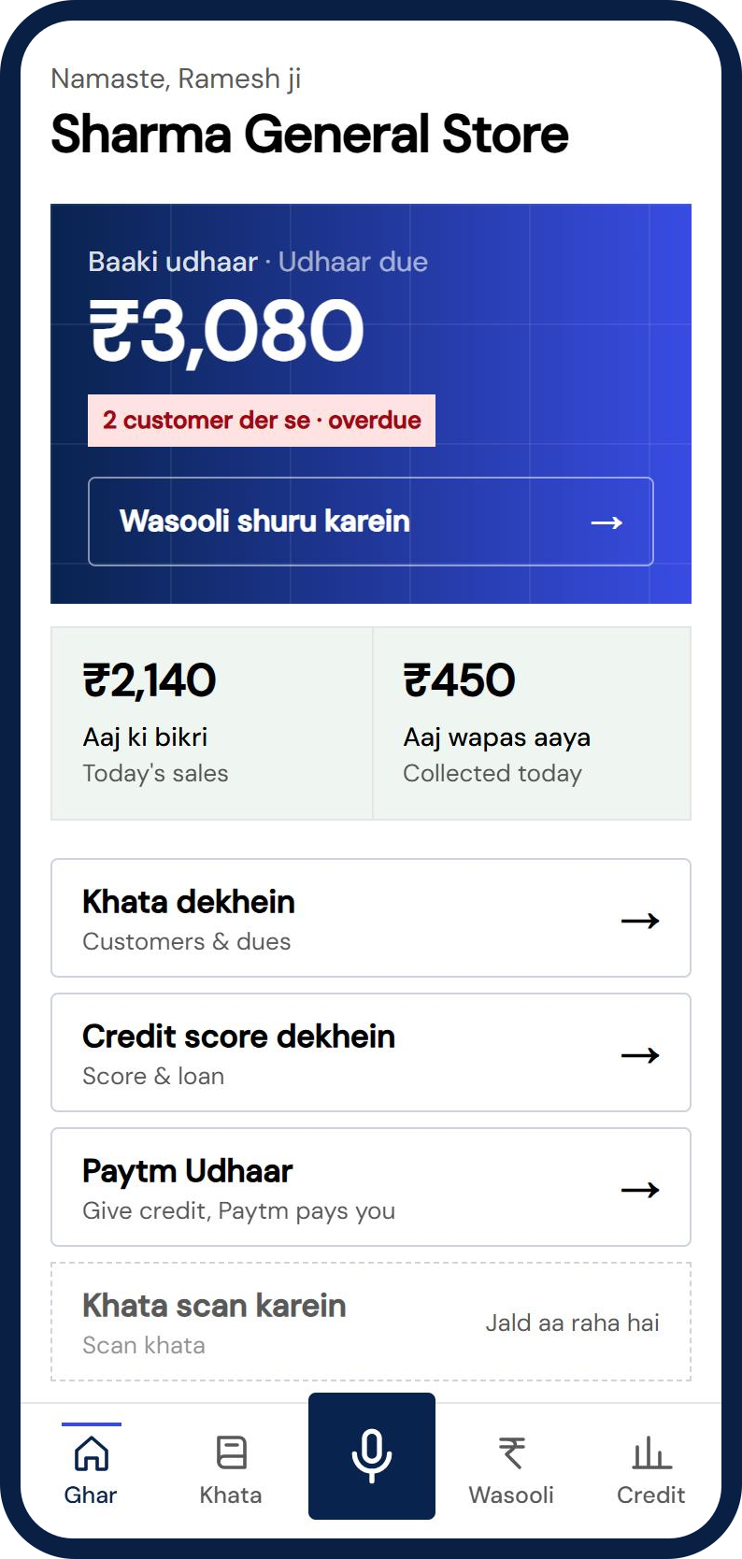
PAYTM BUILD FOR INDIA AI HACKATHON · TRACK 1 · MERCHANT GROWTH AI
Hisaab AI
The voice-first AI business partner for every kirana shop. Collect udhaar today, unlock credit tomorrow.
Team BRX Devs
Shivam Singh Mer · Hansika Katiyar · Janvi Chaturvedi
Stage 1 Pitch · Working prototype · October 2026
Notes:
Hisaab AI turns the handwritten khata of a kirana shop into collections today and credit tomorrow. The shopkeeper never types: they speak in Hindi or Hinglish. What you see on the right is the real working prototype, not a mockup.

Slide 2
THE PROBLEM
A healthy shop, locked out of money
12–13M
₹30 lakh cr
12% vs 3%
kirana stores in India, most keep credit in a paper notebook
MSME credit gap, about 24% of demand (SIDBI, May 2025)
MSMEs relying on informal loans vs on formal credit (SIDBI 2025)
Money gets stuck
No access to loans
Apps don't fit the shop
Udhaar sits in a notebook. Asking in person is awkward, so it is delayed or never recovered.
Banks need verifiable records. A khata page is not one, so good shops get no working capital.
Ledger apps need typing. A busy counter, Hindi first, cheap phone: nobody keeps it up.
Notes:
Three pains: recovery, credit and tooling. Numbers are from SIDBI. Existing ledger apps assume the owner will type; a shopkeeper at the counter will not.

Slide 3
THE SOLUTION
One ledger, three moves: Capture, Collect, Credit
1 Capture
2 Collect
3 Credit
Instead of a paper notebook: say "Gupta ji, do kilo chawal, 120 udhaar". Hindi number words, new customers and follow-ups handled by voice. Khata photo scan is next.
Instead of awkward asking: polite reminders with a Paytm UPI link, an AI voice call that takes a promise date, and promise tracking that feeds the score.
Instead of a loan nobody can verify: a 300–900 score built from the ledger, explained in Hindi. A loan offer, then a teach-back check so the owner understood the terms.
Zero typing · Hindi / Hinglish, spoken back · Merchant approves every financial step · Polite, never threatening · Every score explains why
Notes:
Everything runs off one shared ledger. Stock, Ask, Protect and Comply are roadmap modules on the same data.

Slide 4
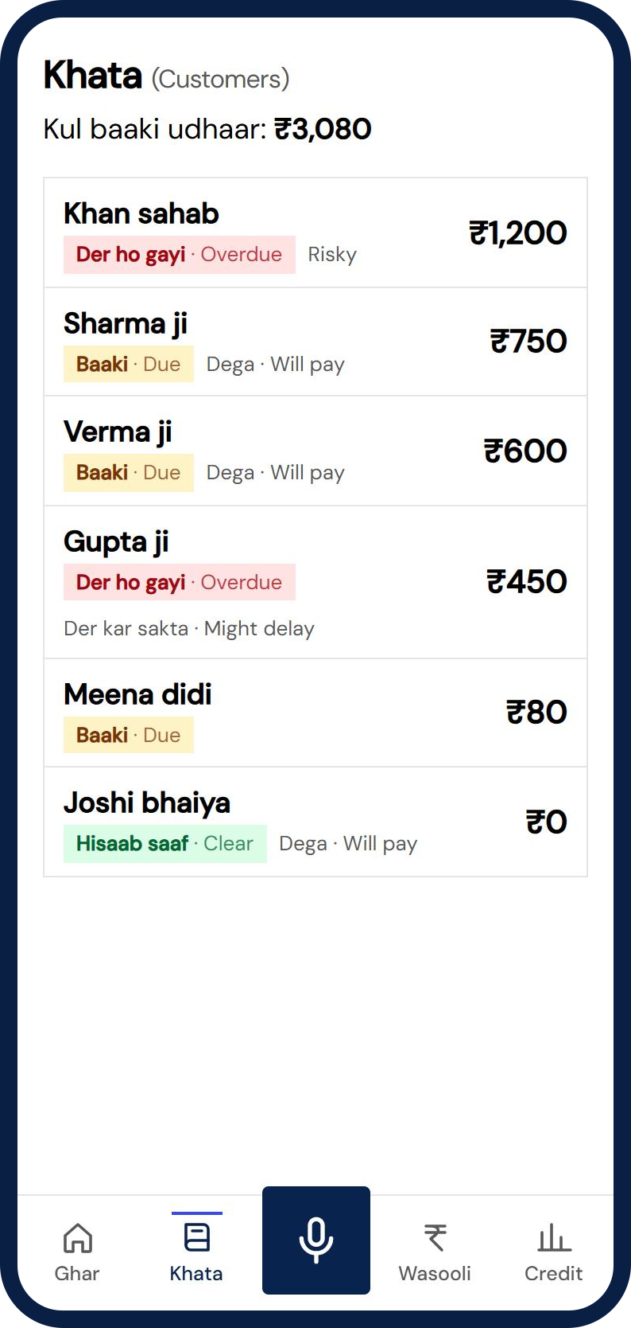
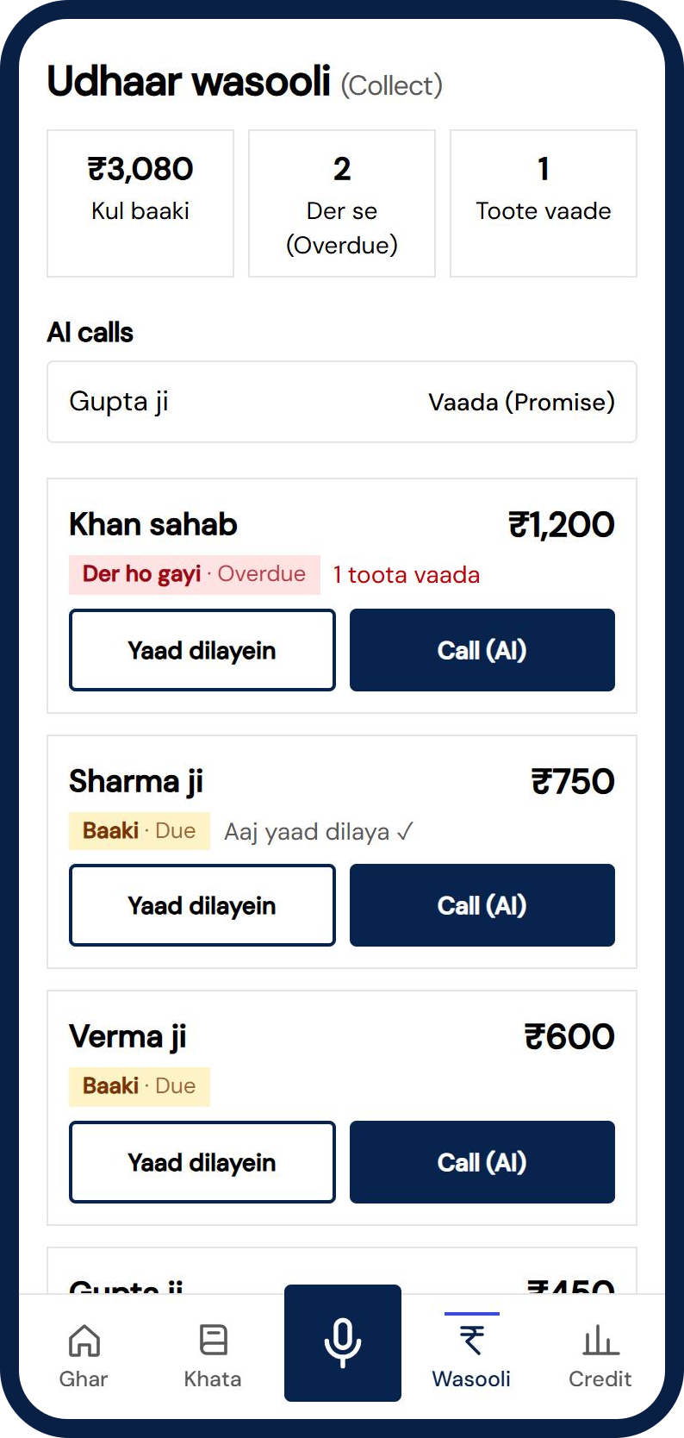
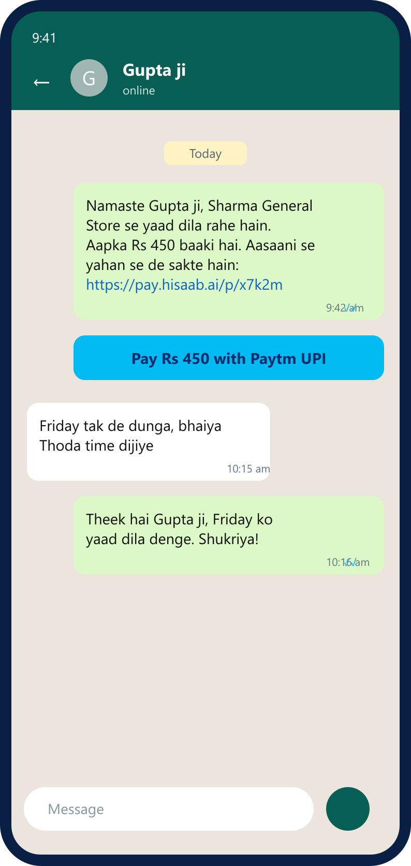
WORKING PROTOTYPE
It runs today: voice in, hisaab out
Home
Khata
Collect
WhatsApp reminder
Total due, today's sales, one big mic
Customers sorted by what they owe
Due, promises and AI call log
Polite message with a Paytm UPI link (sample chat)
Next: khata photo scan · scheduled jobs · real UPI / Soundbox sync · WhatsApp and live calls · pilot with a few shops
Notes:
Screens are from the real app on sample data for the demo shop, Sharma General Store. In the live demo Gupta ji starts at 330 rupees, the voice entry adds 120, and the AI call quotes 450.

Slide 5
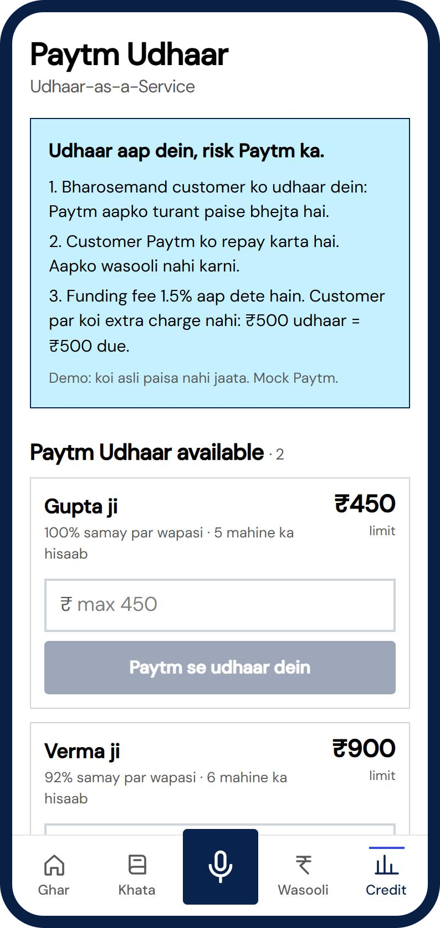
OUR BIGGEST IDEA
Paytm Udhaar: the shop gives credit, Paytm carries the risk
1
Eligible customer
Rule-based from the ledger: 3+ months of history, 80%+ repaid on time, no open dispute.
2
Paytm pays the shop now
Merchant gets cash instantly. Limit is the smaller of ₹5,000 and 1.5x the customer's average ticket.
3
Customer repays Paytm
Through a UPI link. The shop stops chasing. Fee 1.5% is paid by the merchant, customer pays nothing extra.
Prototype: mock state machine, no real money moves.
Notes:
Merchant gets cash today and stops carrying credit risk. Customer builds a repayment history. Paytm gets a lending product on data nobody else has. In the prototype funding and repayment are a mock state machine: funded to closed.

Slide 6
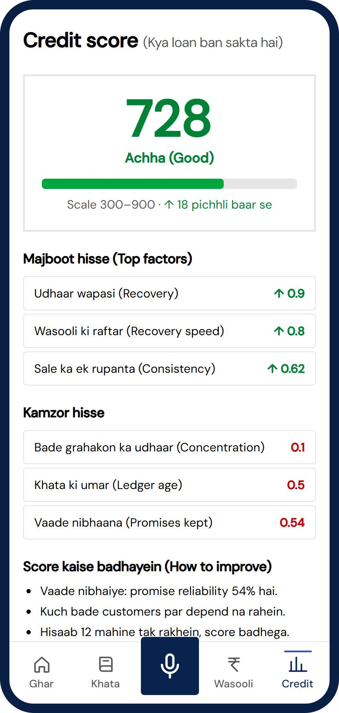
CREDIT YOU CAN EXPLAIN
A score of 728, and the reason in plain Hindi
Transparent scorecard
Offer with consent
7 factors, last 6 months: recovery rate, sales consistency, promise reliability, UPI share, days to recover, tenure, debtor concentration.
Score 600+ and lending consent. Demo shop: up to ₹50,000, 6 months, 21% p.a., EMI about ₹8,851.
Teach-back check
Always asks why
The owner says the EMI and tenure back. A wrong answer gets a simpler re-explanation. Within ±10% passes.
Each factor's points are stored, so the score, the tips and the offer can all be explained.
Notes:
Rule-based on purpose, no black box. Teach-back proves the borrower understood the terms: fewer defaults and less mis-selling. Offer numbers come from the demo shop and are mock lender rules.

Slide 7
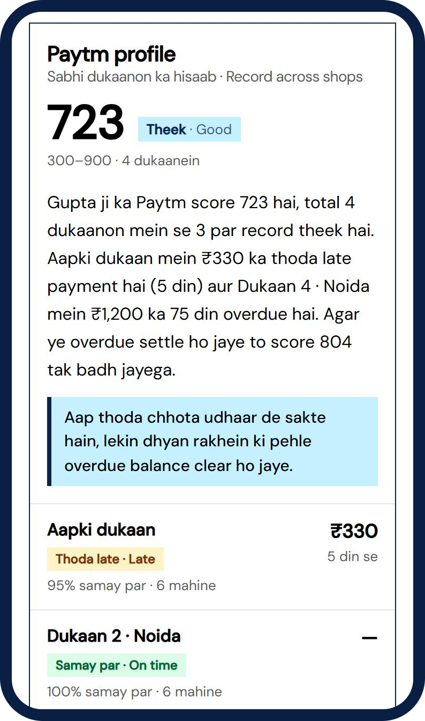
ONE CUSTOMER, EVERY SHOP
Pays three shops, skips the fourth? The score sees it
Gupta ji at | Record | Owes | Score
Aapki dukaan | 95% on time, 5 days late | ₹330 | 0
Dukaan 2 · Noida | 100% on time | — | 0
Dukaan 3 · Noida | 100% on time | — | 0
Dukaan 4 · Noida | Unpaid for 75 days | ₹1,200 | −81
723
Paytm score today (Good)
804
once Dukaan 4 is paid
Skips one shop
Disputed
Small or recent
Can pay, but not this shop. Full penalty: up to 150 points, by days and amount.
Says "maine de diya tha" on the AI call. Counts only 20%: a disagreement, not a default.
Up to 30 days late: no penalty. Paying later brings the points back.
Linked by phone, only with the customer's consent · other shops stay anonymous · rules compute the score, the LLM writes the summary for the shopkeeper
Notes:
The same customer buys on udhaar from several shops. With their consent, Paytm links them by phone and builds one profile. Averaging would hide one unpaid shop behind three good ones, so each balance more than 30 days overdue costs points on its own: 150 x days factor (up to 90 days) x amount factor, cut to 20% if the customer disputes it, total capped at 250. Base score: on-time repayment 40%, nothing long overdue 20%, promises 15%, good at many shops 15%, history 10%. Gupta ji: 804 before the penalty, 723 with the 81-point penalty for Dukaan 4. The shopkeeper sees the score, a Hinglish summary written by the LLM from these numbers, and advice on whether to give udhaar. This also decides Paytm Udhaar eligibility across the network.

Slide 8
HOW IT WORKS
Voice goes in, the ledger changes, the answer is spoken back
Mic audio
›
Sarvam STT
›
Groq LLM (JSON)
›
Neon Postgres
›
Sarvam TTS
Layer | Choice | Why
App | Next.js PWA + Tailwind | One codebase, installs on a cheap Android phone
API | Node.js + Fastify, TypeScript, zod | Shared schemas between web and API, money in integer paise
Voice | Sarvam AI (saaras STT, Bulbul TTS) | Built for Indian languages and code-mixed speech
LLM | Groq (gpt-oss-120b, JSON mode) | Fast structured extraction and classification
Data | Neon Postgres + Upstash Redis | Ledger, AI cache and retries on free tiers
Auth | Neon Auth, emailed OTP | Verified sign-up, JWTs checked in the API
Every query scoped by merchant. The LLM calls tools; it never writes SQL. Every AI call has a timeout, one retry and a cache.
Notes:
The same pipeline serves voice entry, the AI call and the loan journey. Helpers cannot open credit screens; cross-merchant ids are rejected and tested.

Slide 9
IMPACT AND BUSINESS MODEL
Free for the merchant. Paytm earns on what the ledger unlocks
Stream | Who pays | How
Merchant loans | Merchant | Interest + processing fee
Paytm Udhaar | Merchant | 1.5% funding fee per transaction
UPI collections | — | More payment volume on Paytm
Insurance | Merchant | Commission on shop and stock cover
Supplier orders · Hisaab Pro | Supplier / Merchant | Reorder fee · optional insights plan
Shopkeepers
Paid sooner, a path to working capital, no paperwork.
Customers
Gentle reminders in their language, a repayment history.
Flywheel: more entries → better score → more credit → bigger business → more entries. ₹0 to start on free-tier infrastructure.
Paytm
More UPI volume, engaged merchants, a new lending book.
Pilot KPIs: days to recover udhaar · share recovered · loans approved per 100 shops
Notes:
The core app is free. Paytm earns from lending, UaaS fees, UPI volume, insurance and supplier orders. KPIs are what a pilot would measure, not results we claim today. Close with: Hisaab AI turns India's khata into collections today and credit tomorrow.

